Slide 1
Project website:
https://github.com/ibm/usd
Youssef Mroueh and Mattia Rigotti
IBM Research
NeurIPS 2020

Slide 2
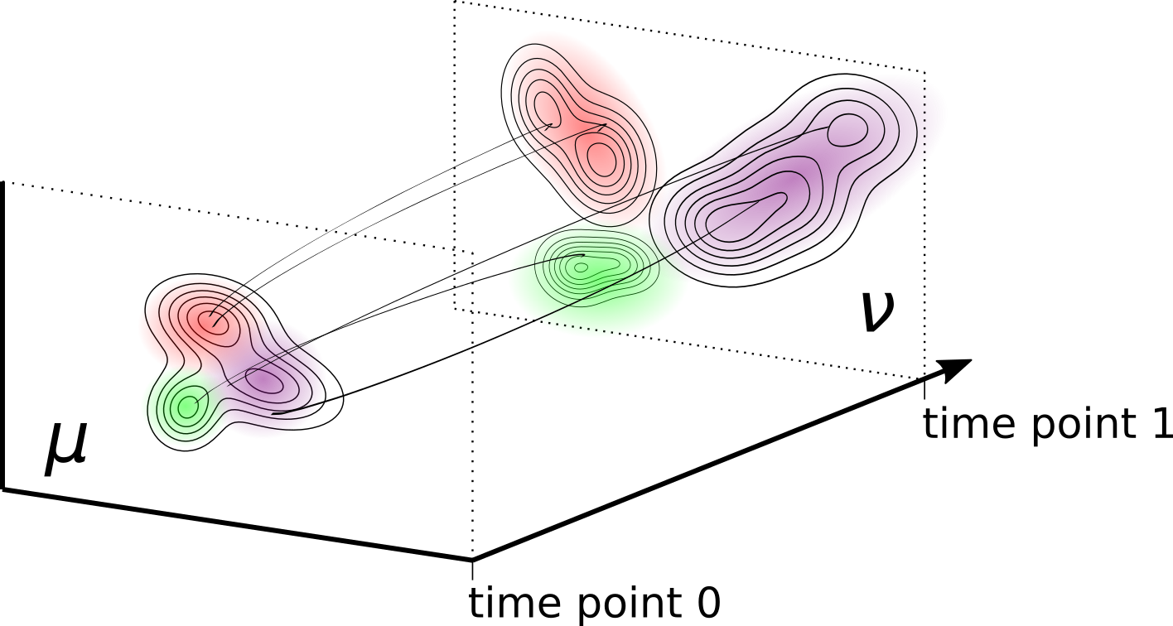
Unbalanced Sobolev Descent (USD)
Unbalanced optimal transport when the two distributions don’t have the same mass
Construction and destruction of mass when moving from one density to another
To move the mass: advection (transporting the mass along a vector field) and reaction (construction and destruction of mass)
Related to the Wasserstein-Fisher-Rao Metric
Image credit: Yang, Karren D., and Caroline Uhler. "Scalable unbalanced optimal transport using generative adversarial networks." arXiv preprint arXiv:1810.11447 (2018).

Slide 3
Sobolev-Fisher Discrepancy
Advection
Reaction

Slide 4
Unbalanced Sobolev Descent (USD)

Slide 5
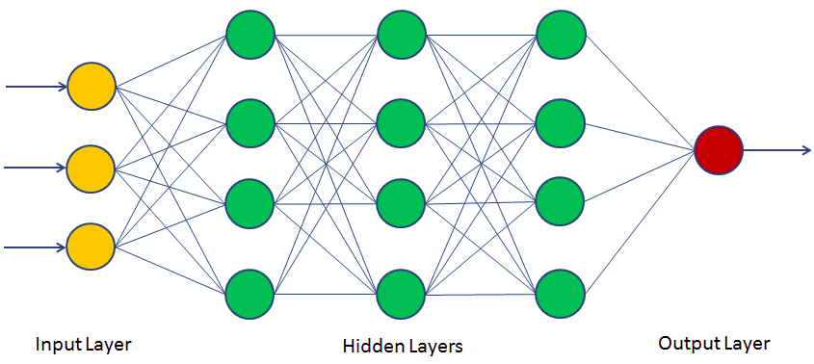
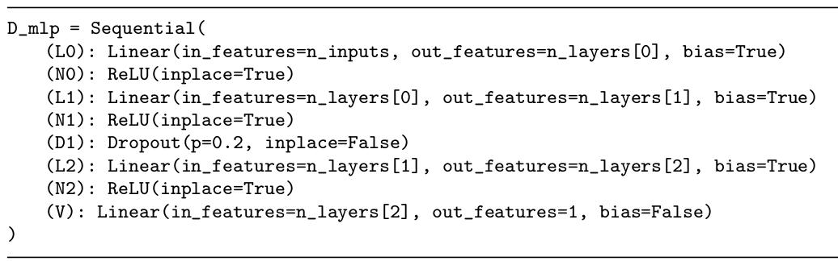
Practical Implementation with neural networks
Death–Birth process implementation, kill/duplicate particles with log probability proportional to the critic value, where the critic is a neural network
Weighted Implementation associate a weight to each particle, and update weights and particles locations

Slide 6
Accelerated Convergence

Slide 7
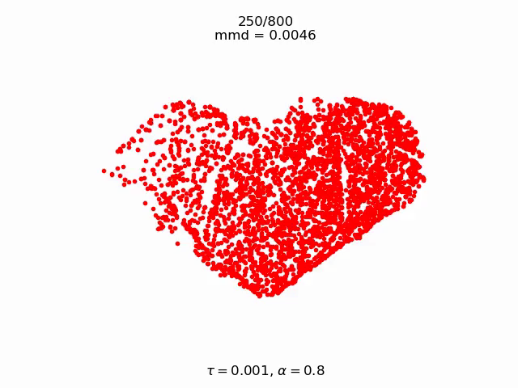
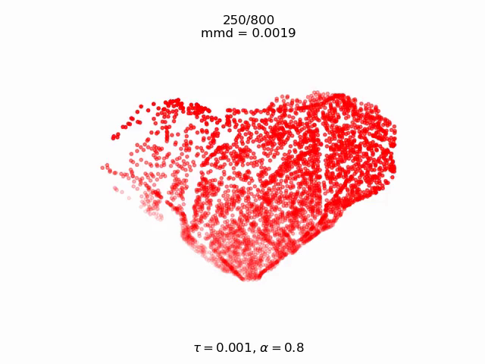
Particles Gradient Flow Animations
Death and Birth USD
Weighted USD

Slide 8
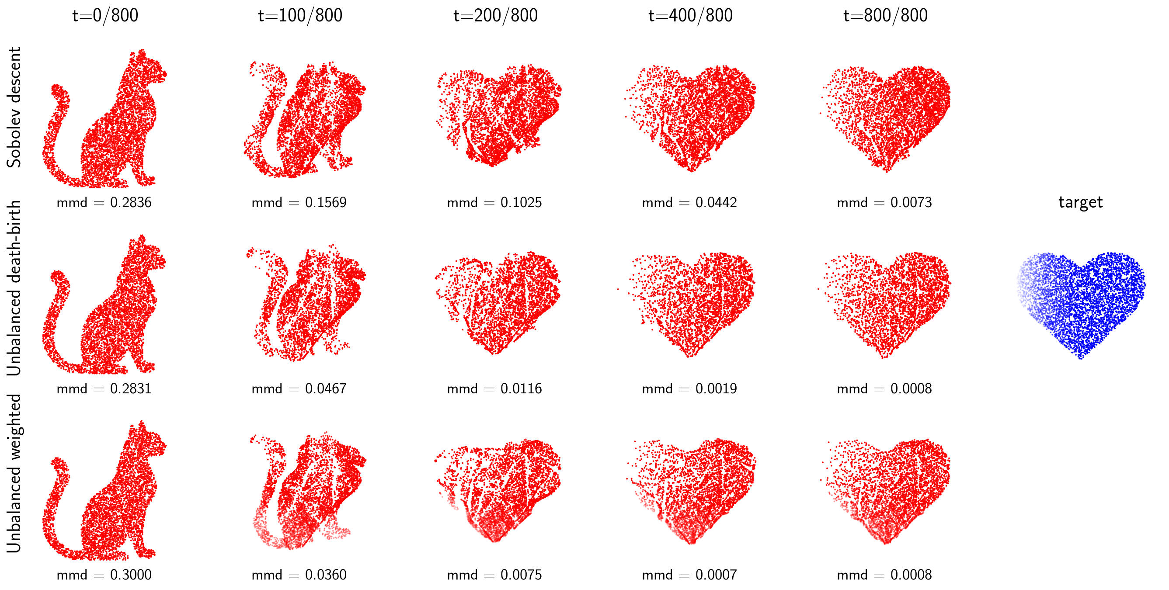
Particles Gradient Flow
*
* The Sobolev descent algorithm was presented in: Mroueh, Youssef, Tom Sercu, and Anant Raj. "Sobolev descent". The 22nd International Conference on Artificial Intelligence and Statistics. 2019.

Slide 9
Color Transfer

Slide 10
Developmental Trajectories in Single-Cell Gene Expression Data
Goal is to interpolate developmental trajectories
Gene expression profile of cell population
t = 0
Gene expression profile of cell population
t = 1
Geoffrey Schiebinger, et al. “Optimal-transport analysis of single-cell gene expression identifies developmental trajectories in reprogramming”. Cell,176(4):928–943, 2019.

Slide 11

Thank you
Project website:
https://github.com/ibm/usd
Questions?
mroueh@us.ibm.com mrg@zurich.ibm.com

